Slide 1
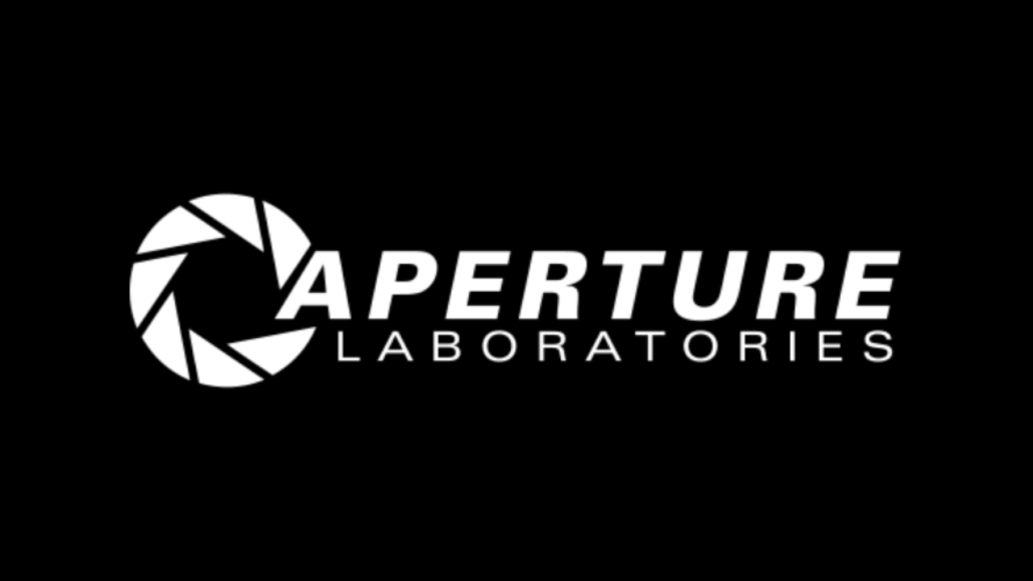

Slide 2
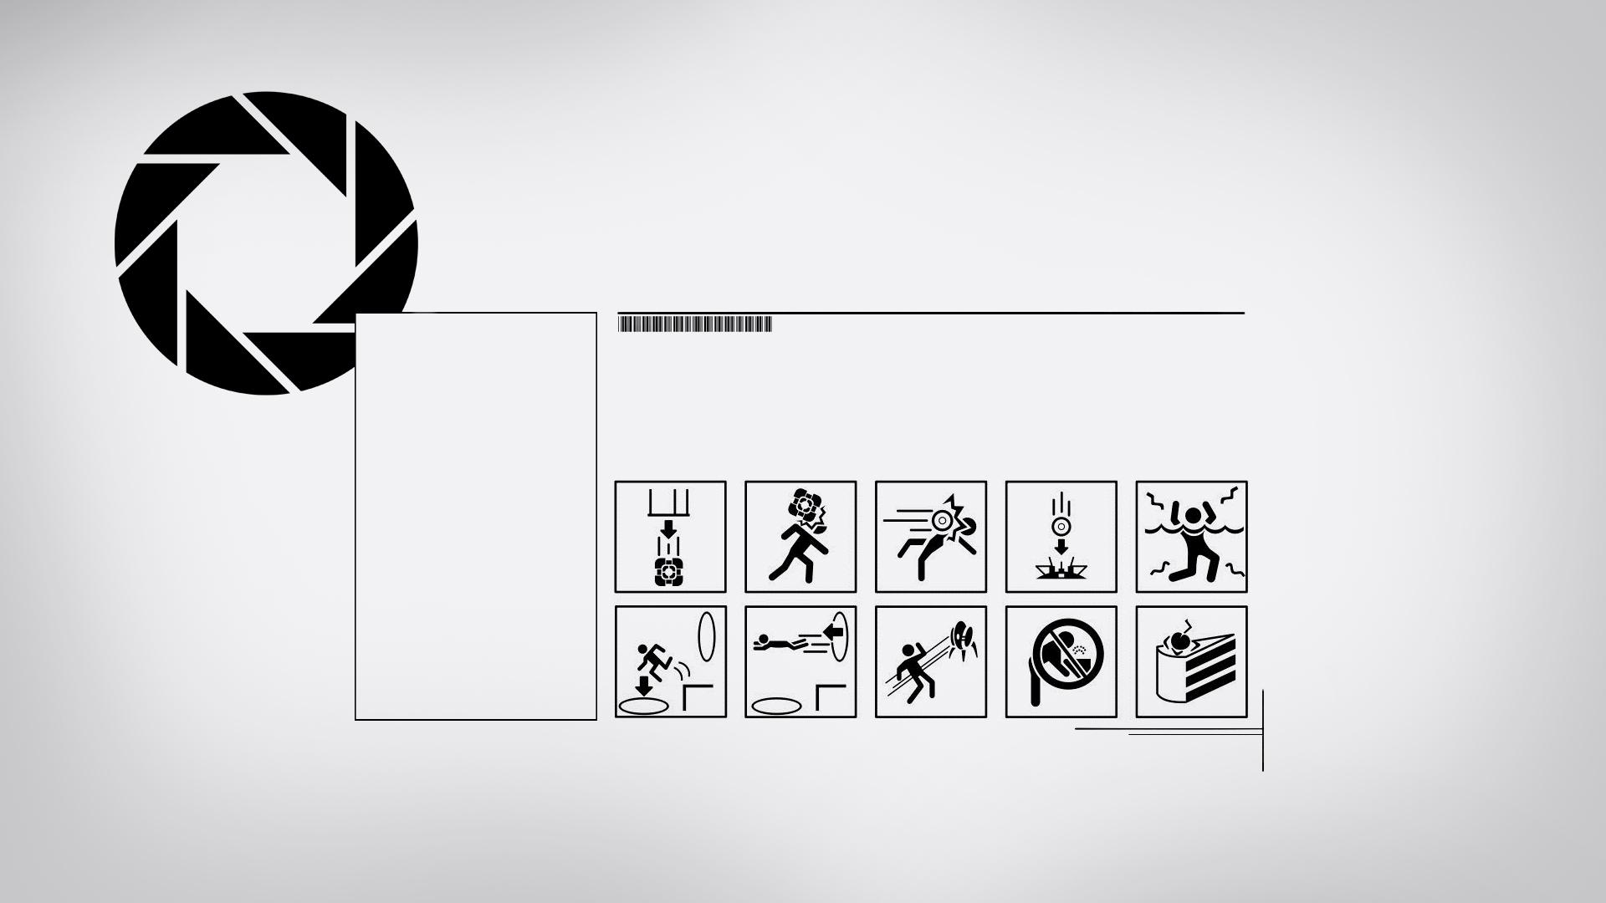
JAVA PROJECT
Riccardo Cavasin

Slide 3

APERTURE SCIENCE’S DESIGN ANALYSIS
Aperture Science Inc. is a fictional United States-based scientific research corporation appearing in Portal and Portal 2.
The goal of this project was recreating the typical graphic style associated with Aperture and Portal

Slide 4


MAIN ELEMENTS
The “Aperture UI” is realized almost completely using two fonts:
-DIN 1451, Mittelschrift
-Univers, ultra condensed

Slide 5
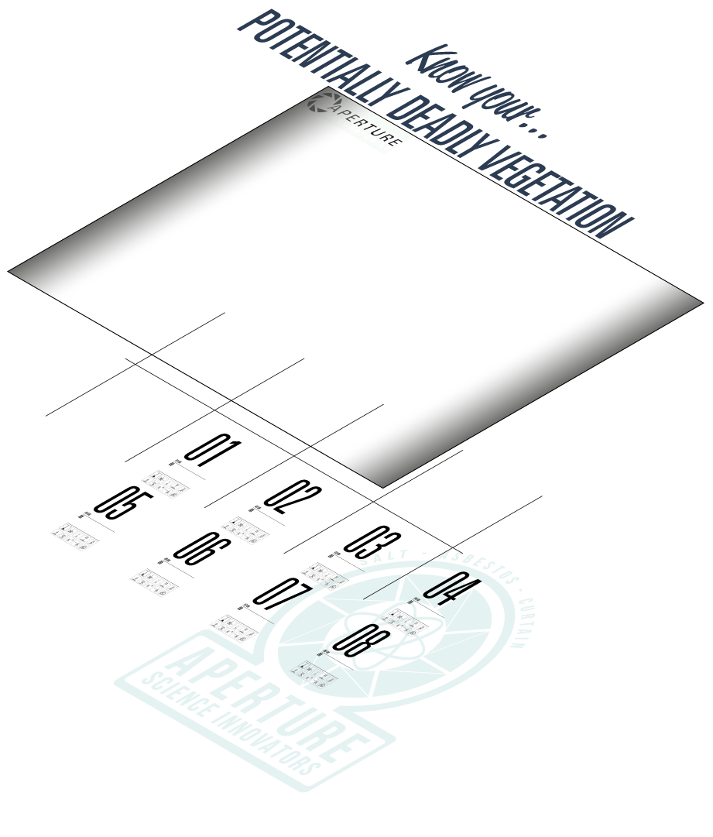

COMPOSING A BACKGROUND
I’ve drawn the background in Adobe Illustrator CC,
Using some images as reference

Slide 6
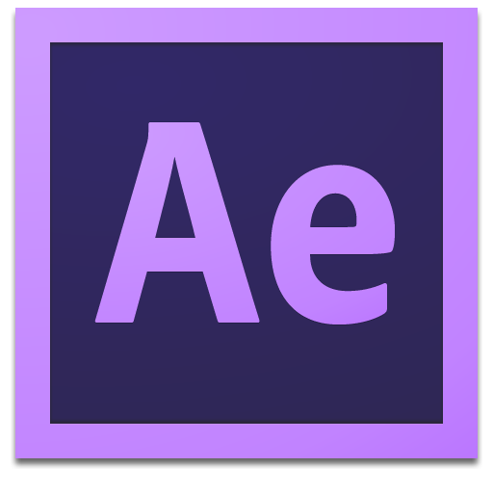
COMPOSING AN ANIMATION
The loading animation was done in Illustrator and After Effects

Slide 7
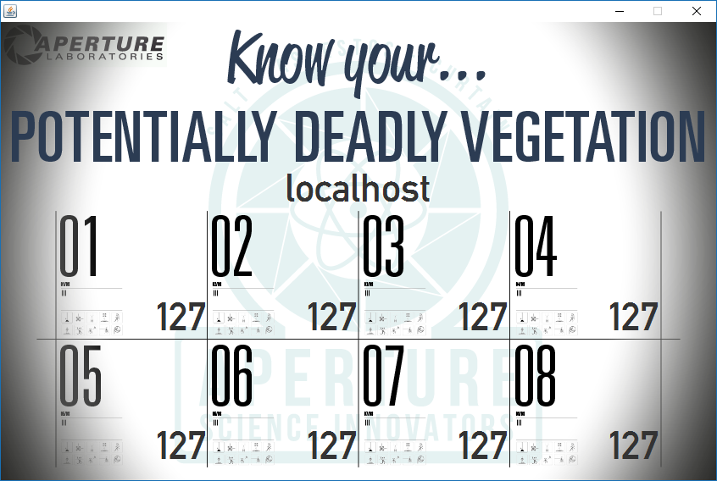
CODE DETAILS
The program uses both TCP and UDP connections.
Data is sent by the client trough tcp, to assure reliability,
the server uses instead an udp connection to broadcast periodically the stored values

Slide 8
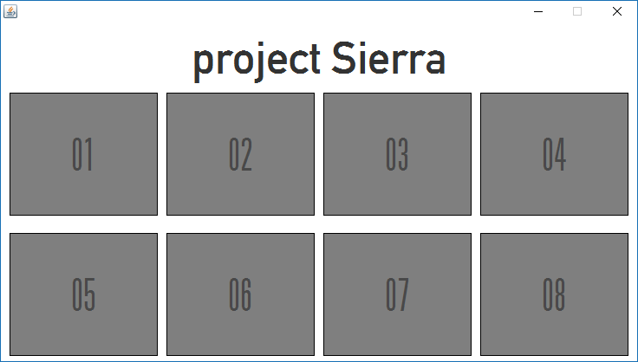
CODE DETAILS
The program uses both TCP and UDP connections.
Data is sent by the client trough tcp, to assure reliability,
the server uses instead an udp connection to broadcast periodically the stored values

Slide 9
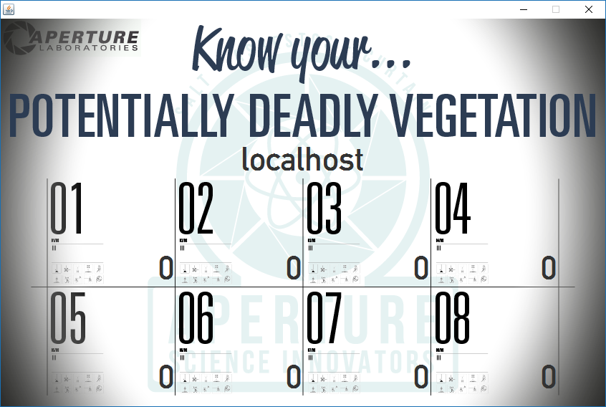
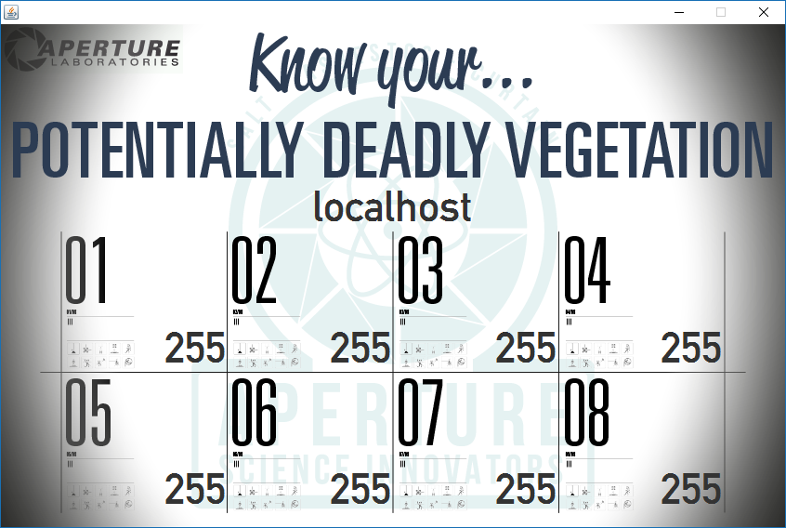
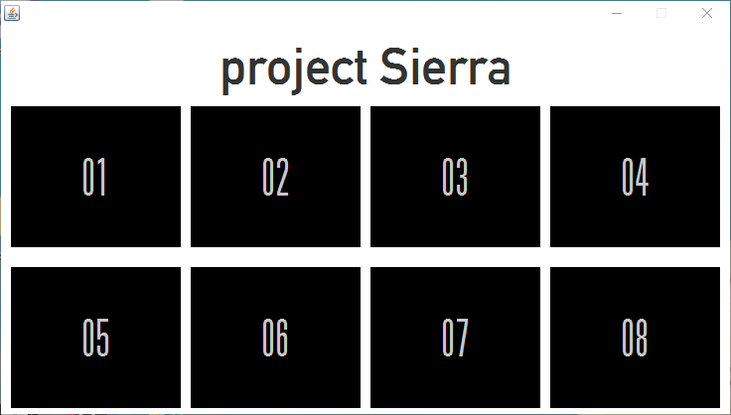
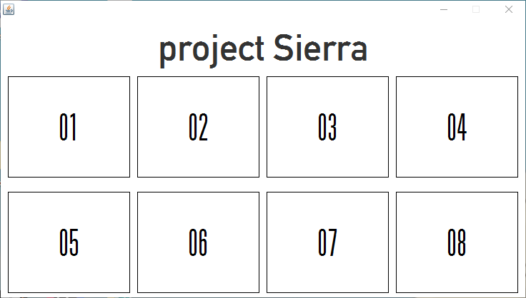
SCREENSHOTS

Slide 10
TIME
Further developments:
-add audio playback
Project completed in two days and half:
Sunday 21: Aperture design study and analysis, font research, background and animation completion
Monday 22: code backbone completed
Tuesday 23: fine tuning, presentation completed

Slide 11
END
Thank you,
Cave Johnson.
Forms FORM-29827281-12:
Test Assessment Report
This was a triumph.
I'm making a note here:
HUGE SUCCESS.
It's hard to overstate
my satisfaction.
Aperture Science
We do what we must
because we can.
For the good of all of us.
Except the ones who are dead.
But there's no sense crying
over every mistake.
You just keep on trying
till you run out of cake.
And the Science gets done.
And you make a neat gun.
For the people who are
still alive.
Forms FORM-55551-5:
Personnel File Addendum:
Dear <<Subject Name Here>>,
I'm not even angry.
I'm being so sincere right now.
Even though you broke my heart.
And killed me.
And tore me to pieces.
And threw every piece into a fire.
As they burned it hurt because
I was so happy for you!
Now these points of data
make a beautiful line.
And we're out of beta.
We're releasing on time.
So I'm GLaD. I got burned.
Think of all the things we learned
for the people who are
still alive.
Forms FORM-55551-6:
Personnel File Addendum Addendum:
One last thing:
Go ahead and leave me.
I think I prefer to stay inside.
Maybe you'll find someone else
to help you.
Maybe Black Mesa...
THAT WAS A JOKE. HA HA. FAT CHANCE.
Anyway, this cake is great.
It's so delicious and moist.
Look at me still talking
when there's Science to do.
When I look out there,
it makes me GLaD I'm not you.
I've experiments to run.
There is research to be done.
On the people who are
still alive.
PS: And believe me I am
still alive.
PPS: I'm doing Science and I'm
still alive.
PPPS: I feel FANTASTIC and I'm
still alive.
FINAL THOUGHT:
While you're dying I'll be
still alive.
FINAL THOUGHT PS:
And when you're dead I will be
still alive.
STILL ALIVE
Still alive.

